Slide 1

TUTORIAL FOR THE COLLABORATIVE ENVIRONMENT
- Participant version -

Slide 2
INDEX
Portal public pages
Login and registration
Personal workspace
How a co-production process looks like
How to edit resources
How to create a new resource
How to share the link to a resource

Slide 3
Public pages of the portal

Slide 4
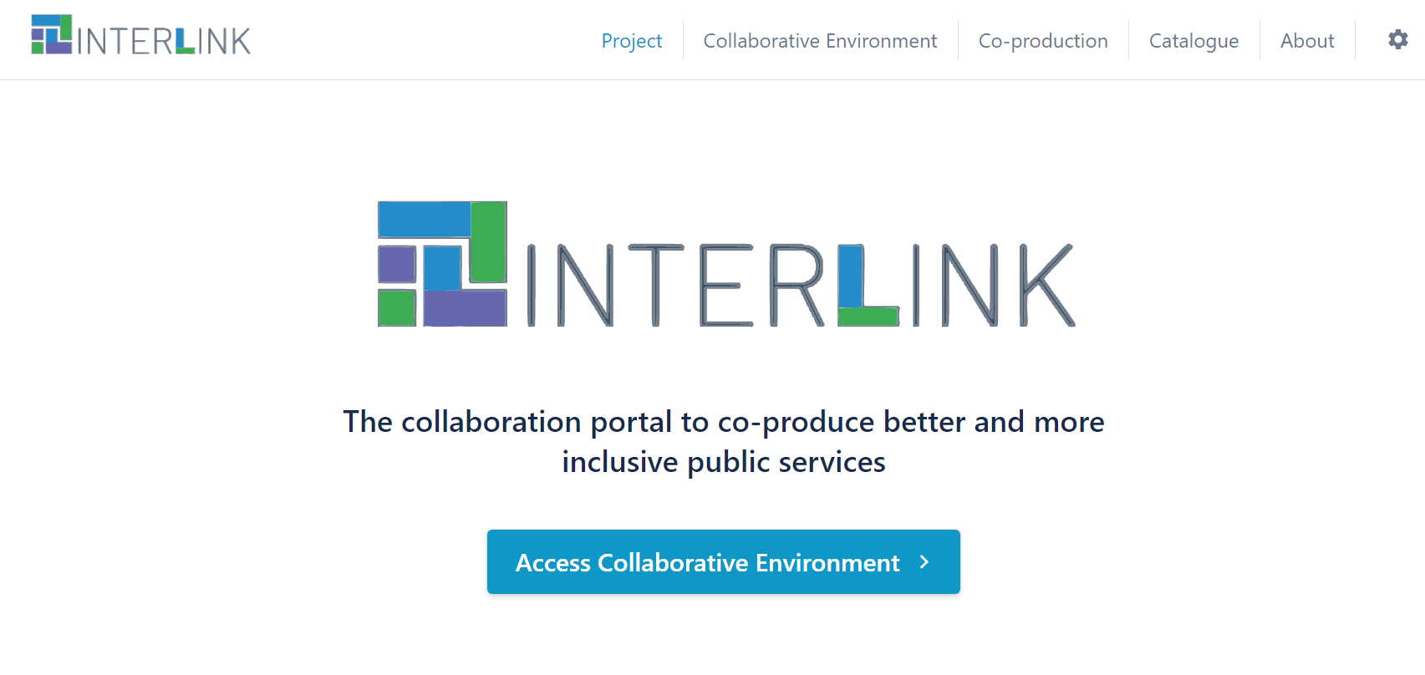
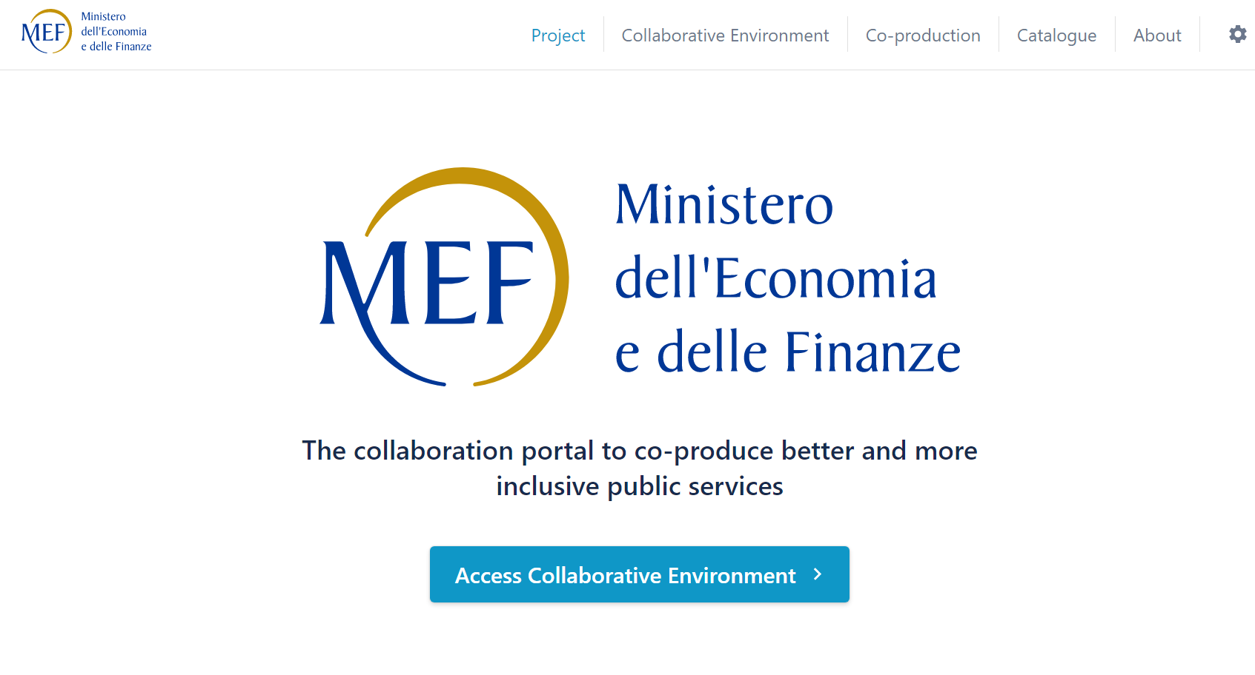
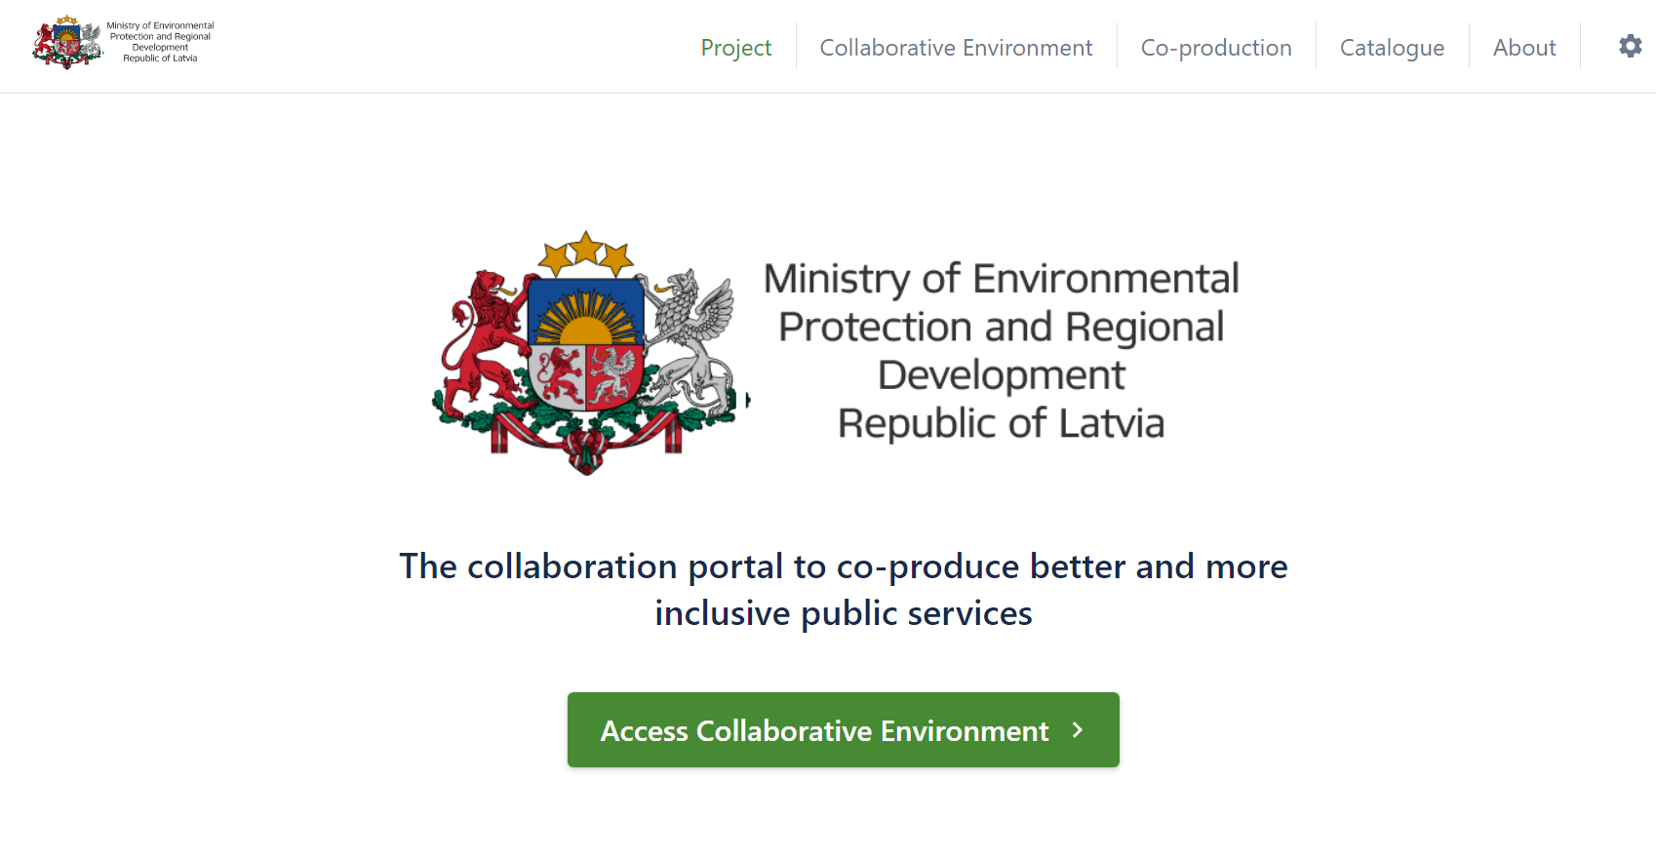
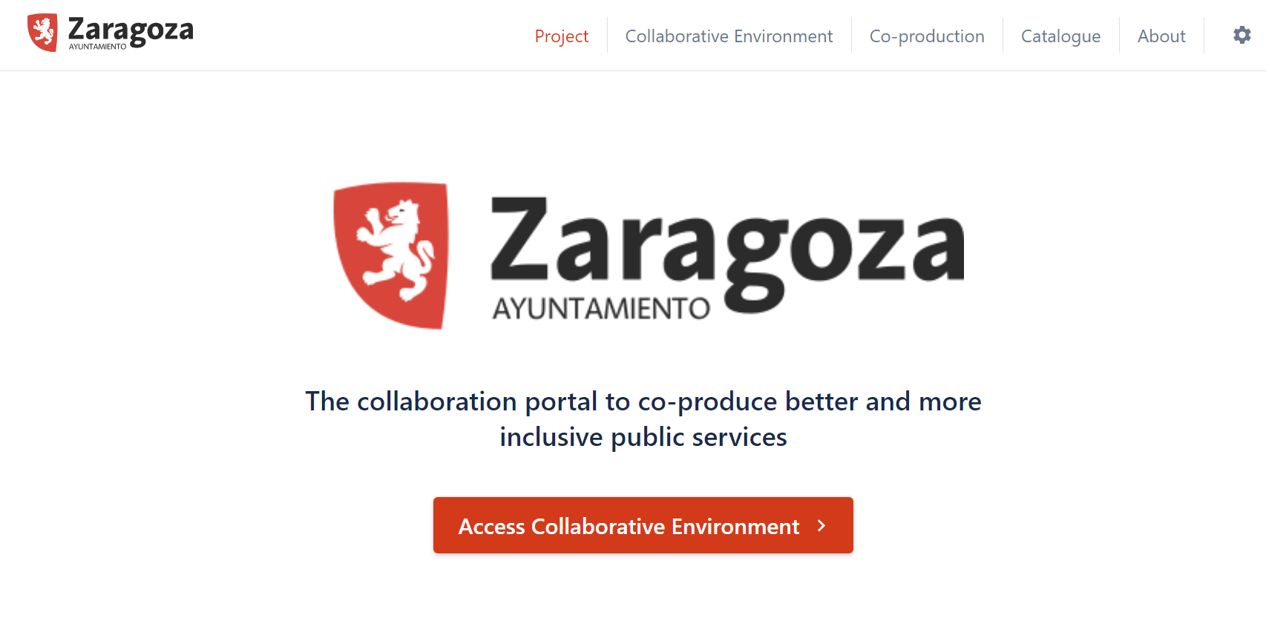
Connect to the portal
Different versions of the portal are available
DEMO
https://demo.interlink-project.eu/
MEF
https://mef.interlink-project.eu/
VARAM
https://varam.interlink-project.eu/
ZARAGOZA
https://zgz.interlink-project.eu/

Slide 5
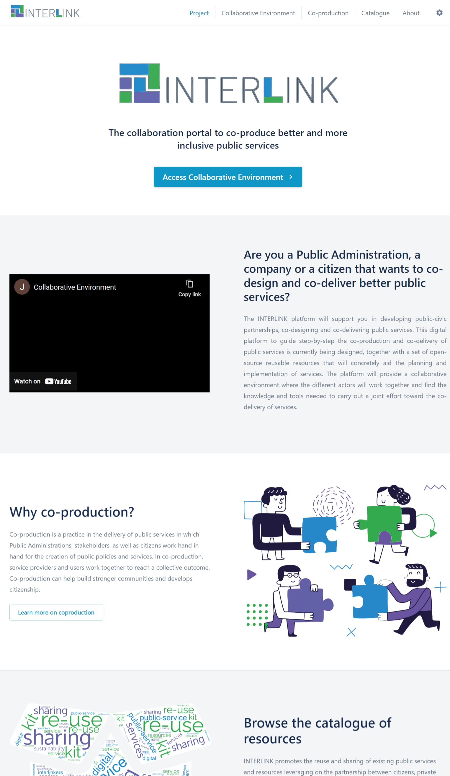
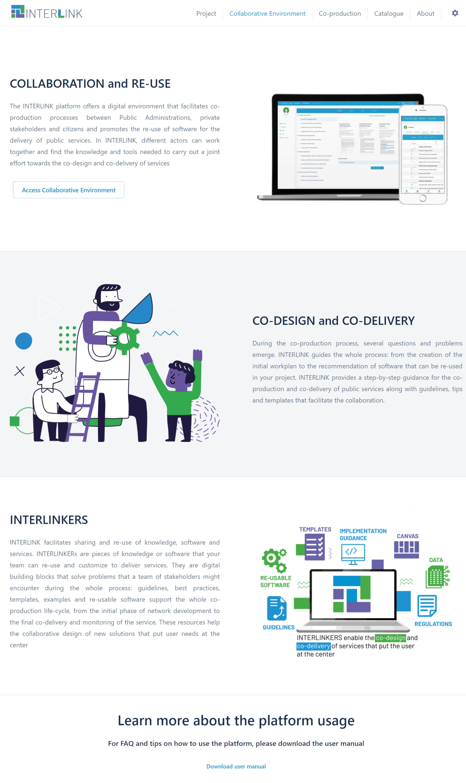
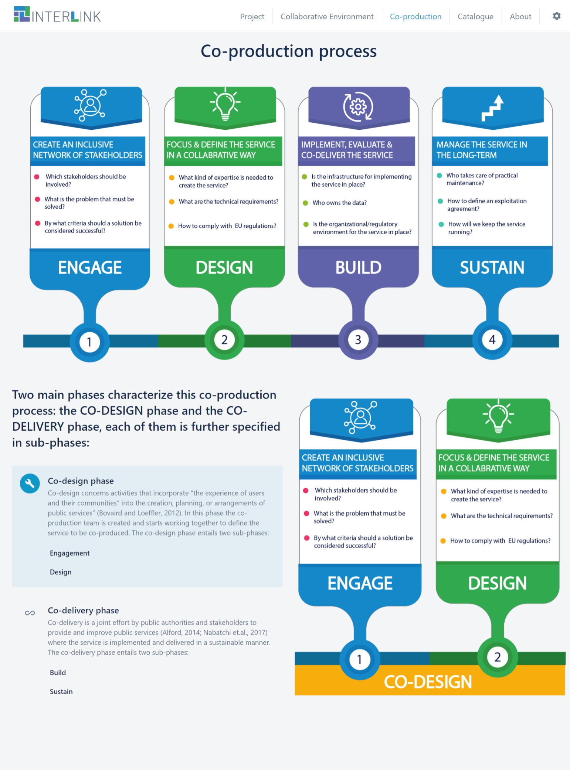
Information on Co-production
The public pages of the portal provide information on the INTERLINK project, on the functionalities of the Collaborative Environment, on Co-production

Slide 6
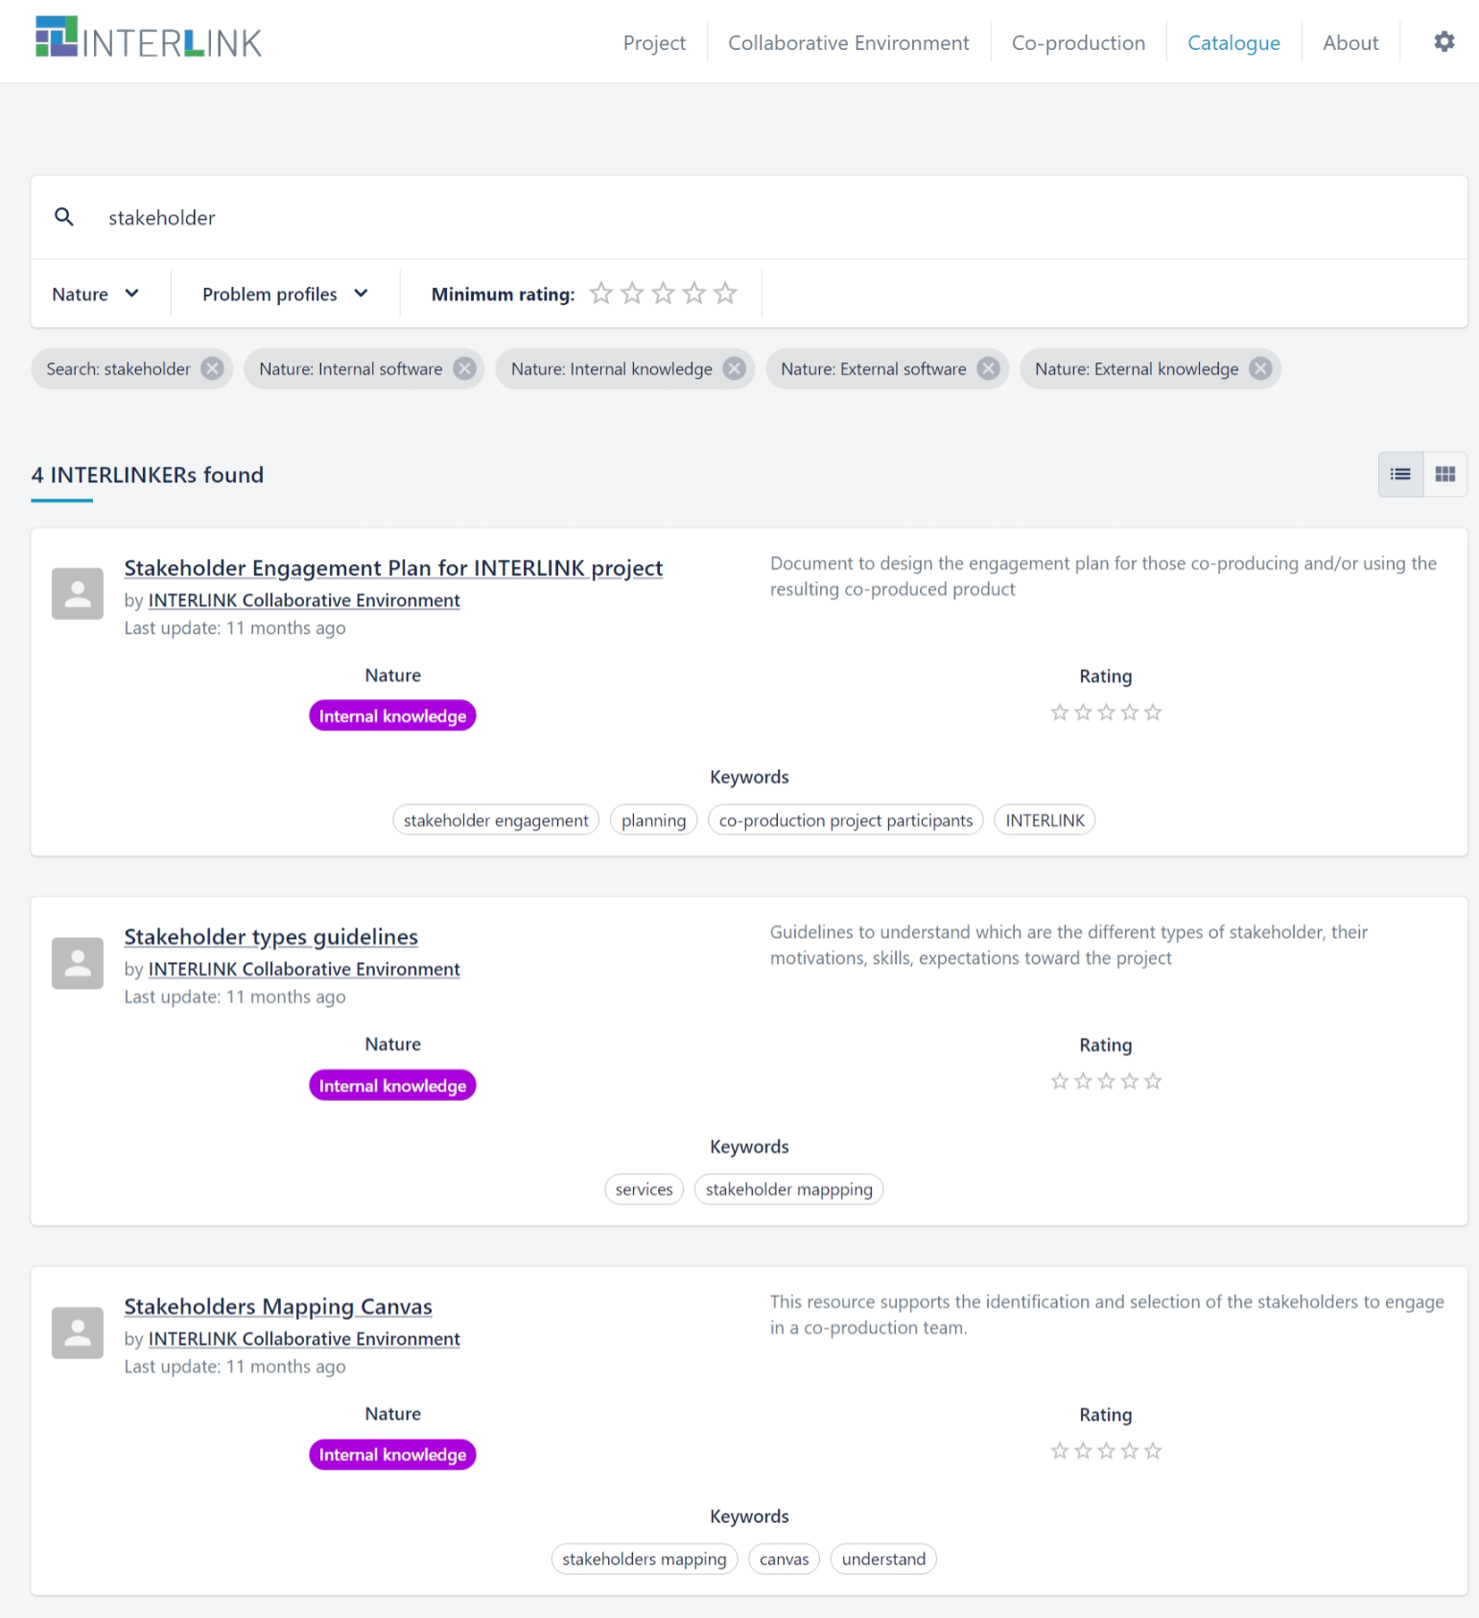
Preview of catalogue of INTERLINKERS
A specific page provides an overview of the reusable knowledge and software resources available in the platform to aid the co-production of public services.
Search and filter functionalities are available.

Slide 7
Access to the Collaborative Environment - Login and registration -

Slide 8
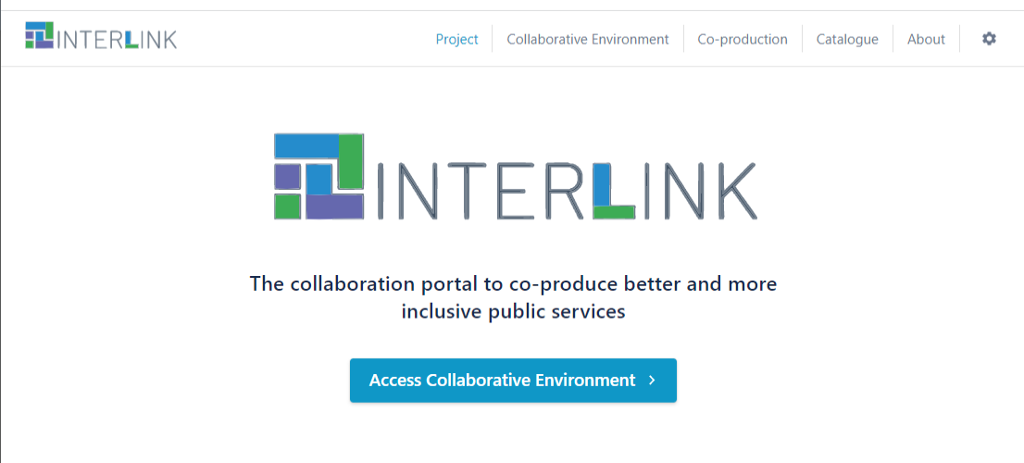
Access the Collaborative Environment
You can access the Collaborative Environment from the home page of the portal.
The home page of the portal is always reachable by clicking on the INTERLINK logo at the top left of the interface.

Slide 9
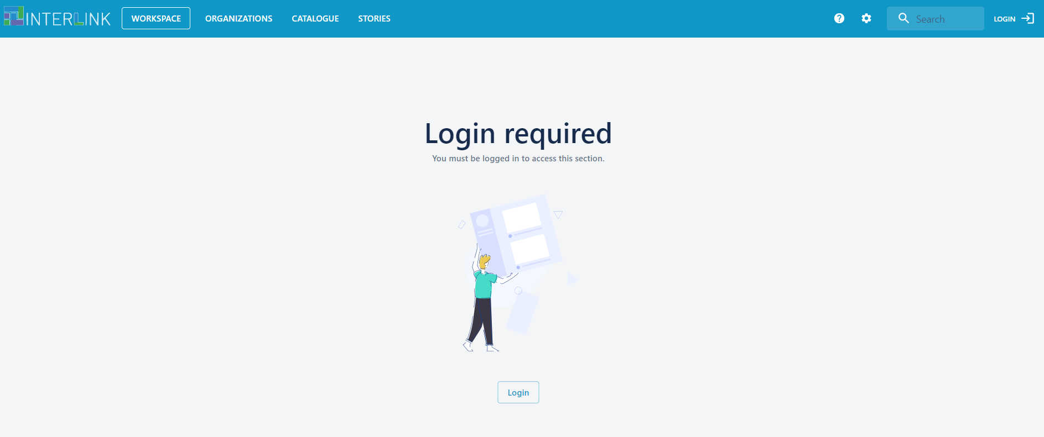
Login
Click on LOGIN

Slide 10
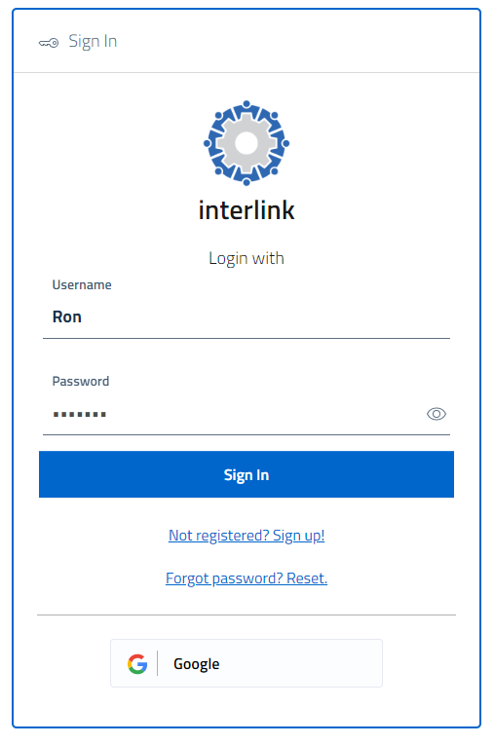
Already registered to the platform?
Sign in with your credentials if you are already have registered to the platform
or
Sign in with you google account if you have one and want to use it to access the platform

Slide 11
Not yet registered to the platform?
Click on “Not registered? Sign up!”

Slide 12
Access with Google credentials

Slide 13
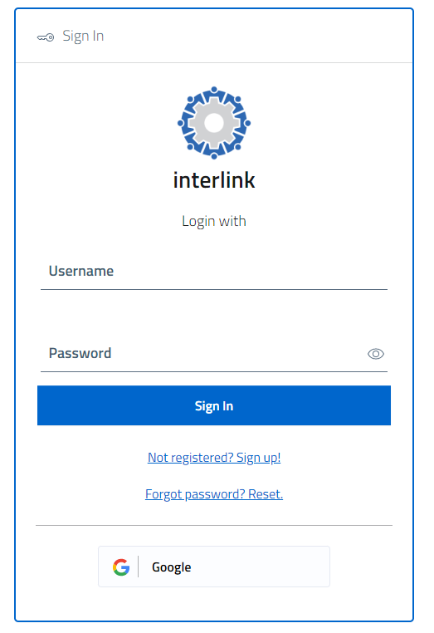
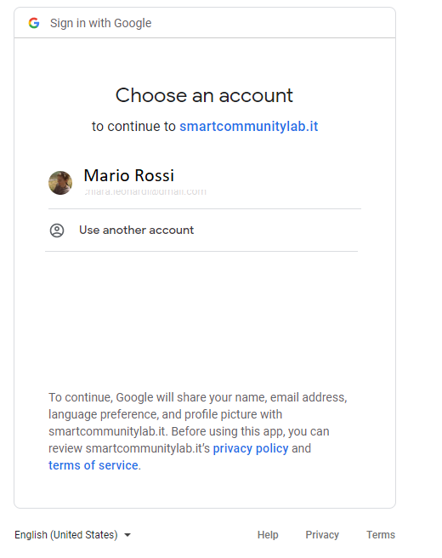
Access with Google credentials
If you have a private or work account managed by Google (for example xxxx@gmail.com) you can enter the platform using your usual Google email and password
(the platform is able to dialogue with Google servers for a safe user identification, in compliance with data protection regulations)

Slide 14
Access for users already registered with username and password

Slide 15
Access with platform credentials
If you have already registered to the platform with a chosen username and password, use your defined credentials to login to the platform
(if you have not registered yet, see next slides)

Slide 16
New registration to the portal

Slide 17
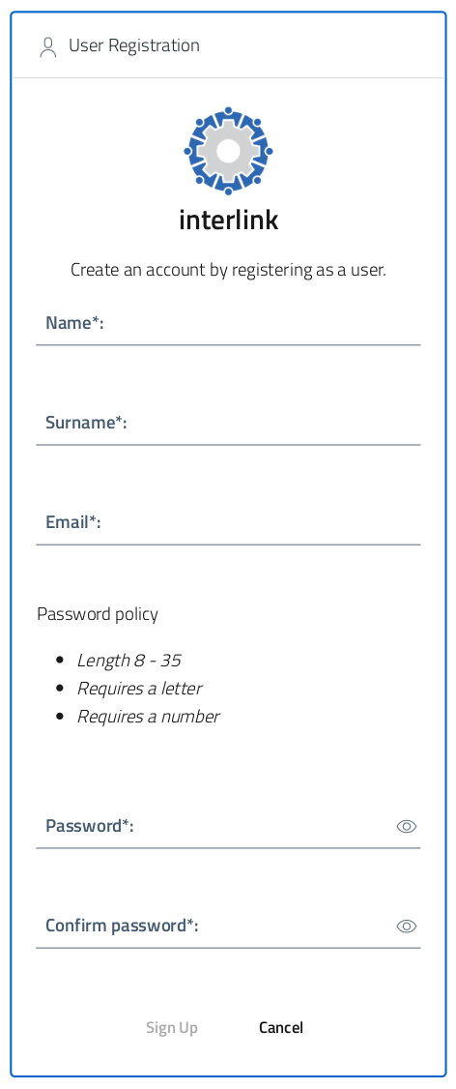
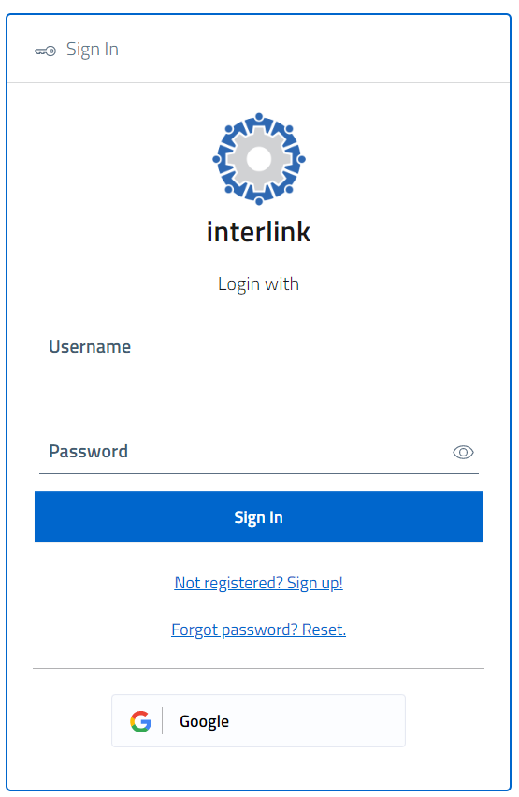
Input your registration data
After clicking on "“Not registered? Sign up!” you get access to the registration form
Insert your data, choose a password and click on the "Sign up" button

Slide 18
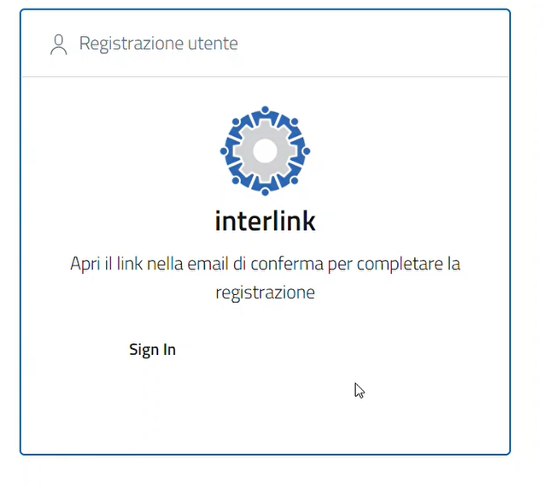
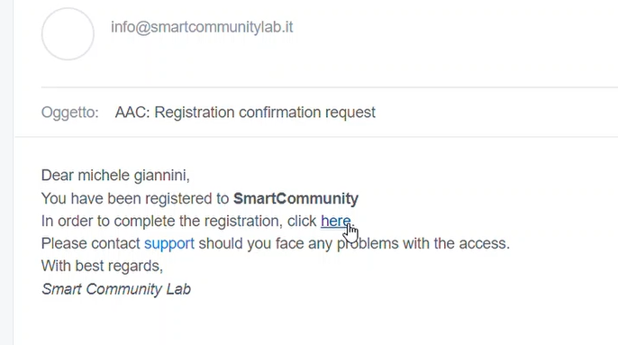
Confirm the registration
Per completare la registrazione e’ necessario aprire il link che verra’ mandato tramite email (controllare eventualmente la cartella SPAM)
A verification message will be sent to the provided email address (check also the spam folder)
Click on the valuation link included in the email message.
Now you can enter the platform with your new credentials.

Slide 19
Welcome to your Workspace

Slide 20
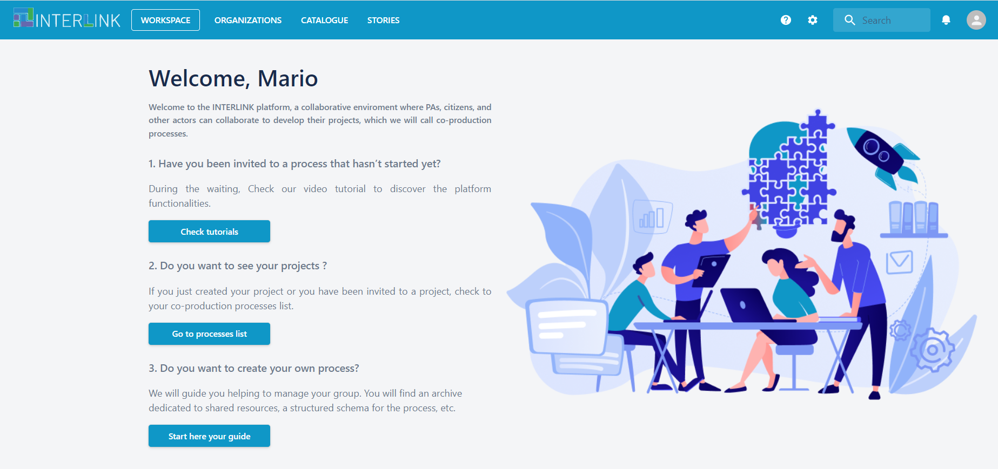
Personal workspace
After you access the Collaborative Environment, a welcome page provides orientation information.

Slide 21
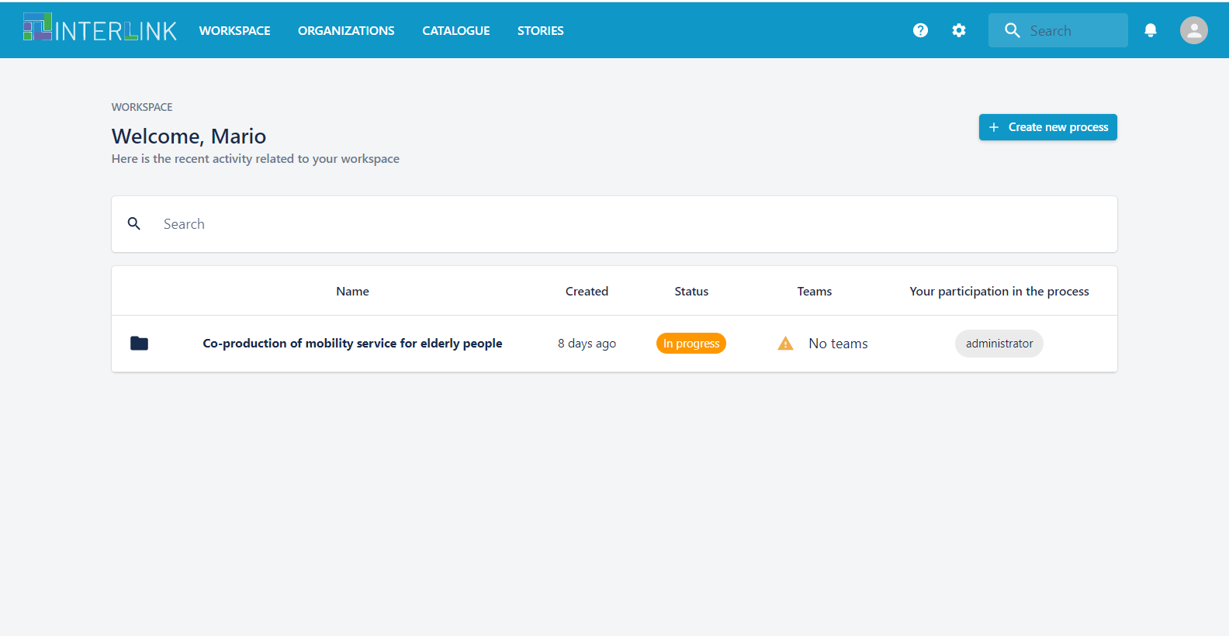
Co-production processes you work on
After having been invited to participate to a co-production process, your workspace contains the list of processes you can work on.

Slide 22
How a co-production process looks like

Slide 23
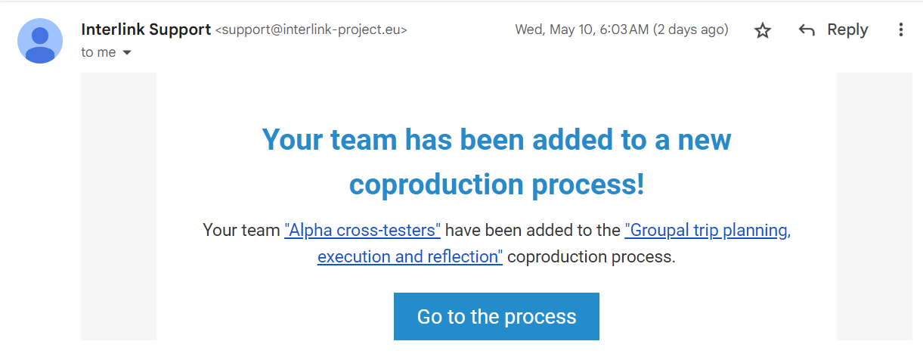
Select the process of your interest
If you have been invited to contribute to a co-production process, you can open it from the list of processes in your workspace.
You can also open it from the email invitation that you have received (you will be redirected to the Collaborative Environment and login will be requested)
SAMPLE INVITATION EMAIL

Slide 24
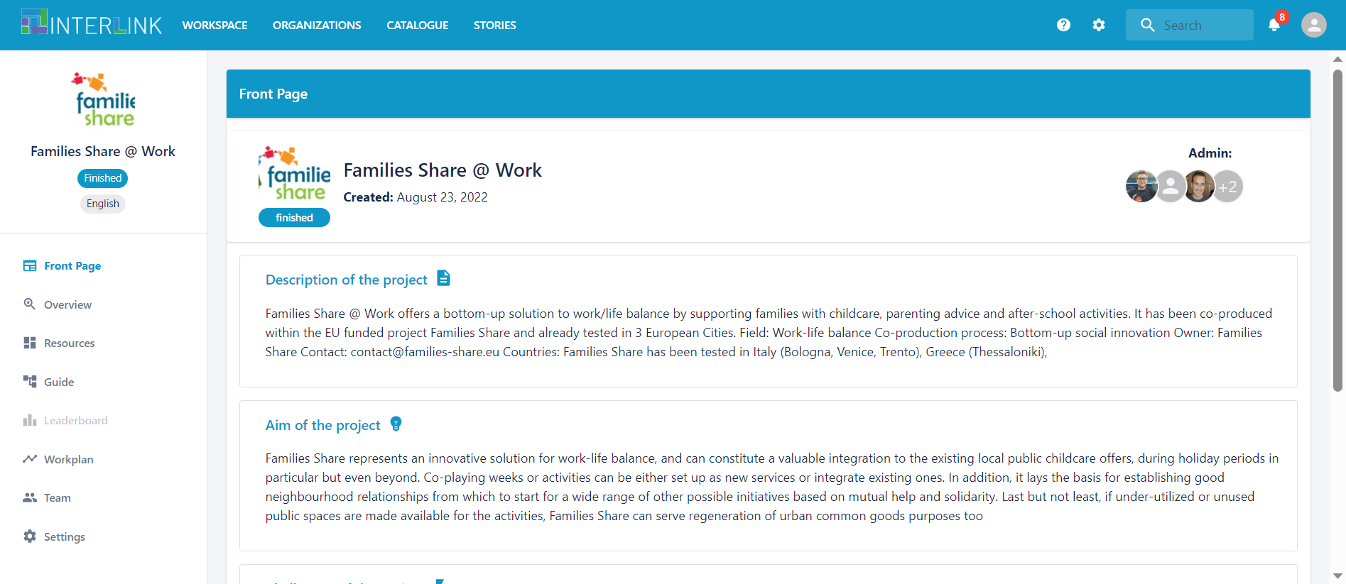
Co-production process front page
The Front Page section provides information on what the co-production process is about

Slide 25
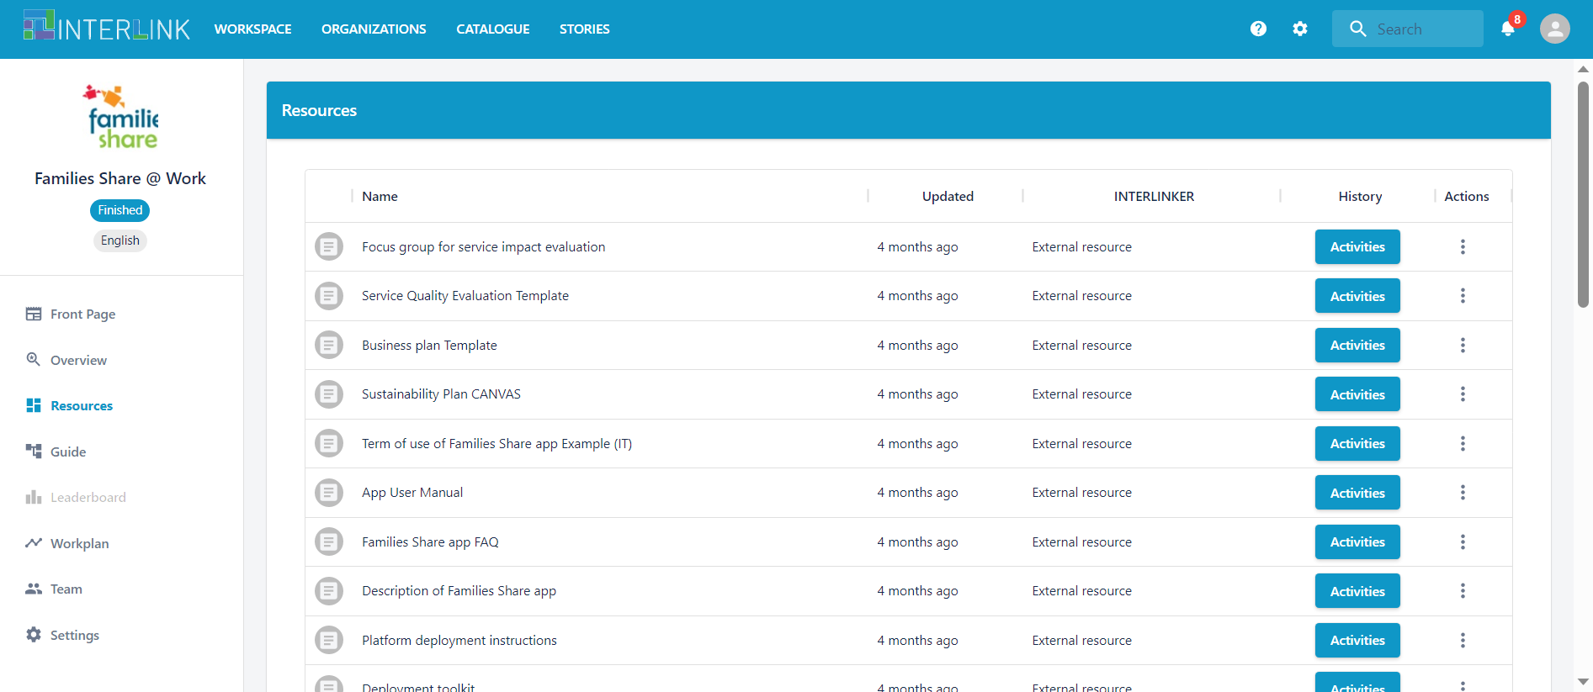
Co-production process resources
The Resources section provides a summary list of all the resources that have been created so far during the co-production process and that have been shared with you

Slide 26
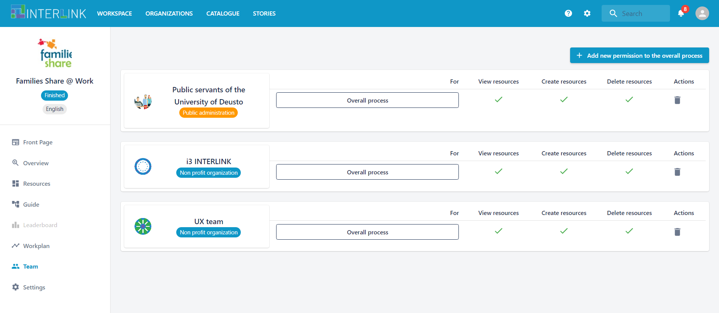
Who is working on a process
The Teams visualizes the list of teams involved in the co-production process.
By clicking on a team name you will able to see its members.

Slide 27
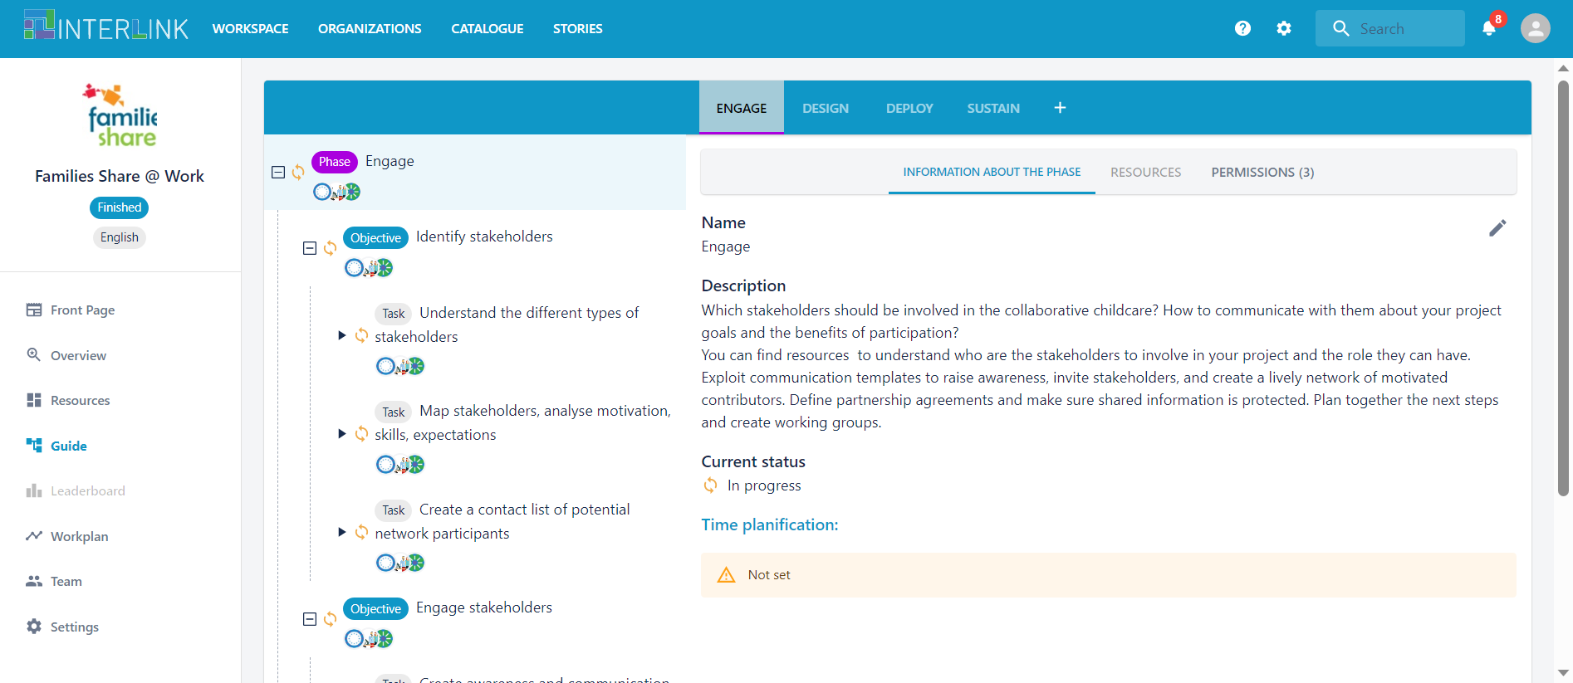
PHASE
OBJECTIVE
TASK
SEQUENCE OF PHASES
Co-production process guided steps
The Guide section allows you to see the list of steps planned for the co-production process (organized in a hierarchical sequence of phases, objectives, and tasks)

Slide 28
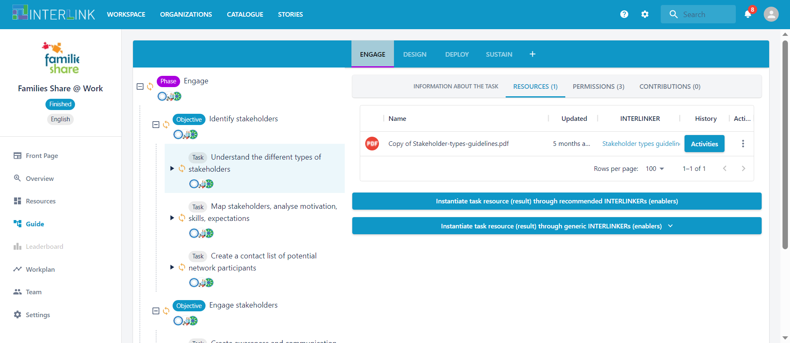
Details for a task
When you select a specific task in the Guide section, you will be able to read a description of the forseen activities as well as the list of resources created and shared with you for this task.

Slide 29
How to edit shared resources

Slide 30
Open a resource from the task
You can open a shared resource from the task where it was created.
You simply need to click on the name of the resource.

Slide 31
Open a resource from the «Resources» section
You can also open a shared resource from the «Resources» section that lists all the resources that have been created in the process.
You simply need to click on the name of the desired resource.

Slide 32
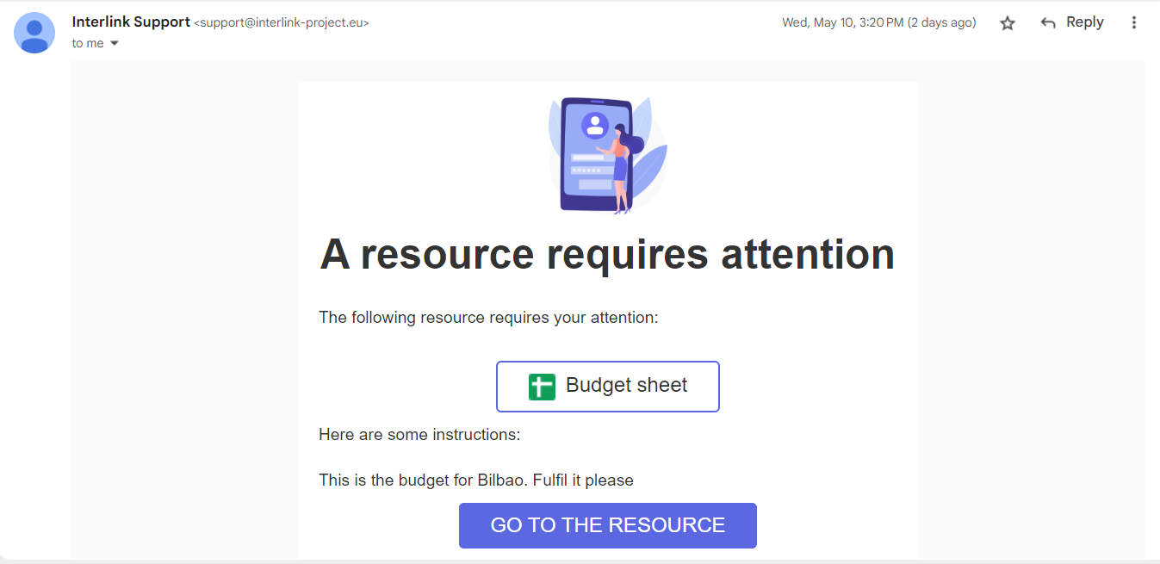
SAMPLE NOTIFICATION EMAIL
Open a resource from an email notification
You might have received an email notification when the resource was shared with you.
You can open the resource by directly clicking on the link in the message you received (you will be redirected to the Collaborative Environment and login will be requested)

Slide 33
How to create a new resource

Slide 34
Create a generic empty document

Slide 35
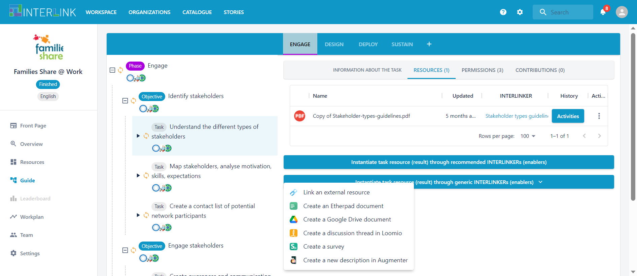
Create a generic empty document
In case you need to create an empty document, navigate to the task where you want to create it. Open the tab showing its resources.
Then click on the second blue button associated to generic INTERLINKERs. In the pop-up that appears, select the type of document you want to create.

Slide 36
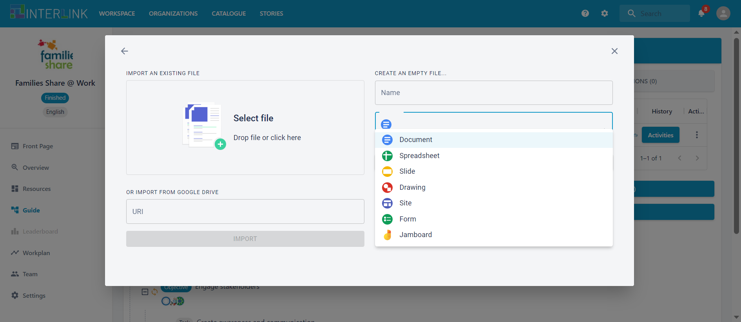
Configure the new empty document
Configure the information related to the new document.
For example, for Google Drive documents you can select the specific type of document to create.
You then have to type the name assigned to the document.

Slide 37
Import an existing document from Google Drive

Slide 38
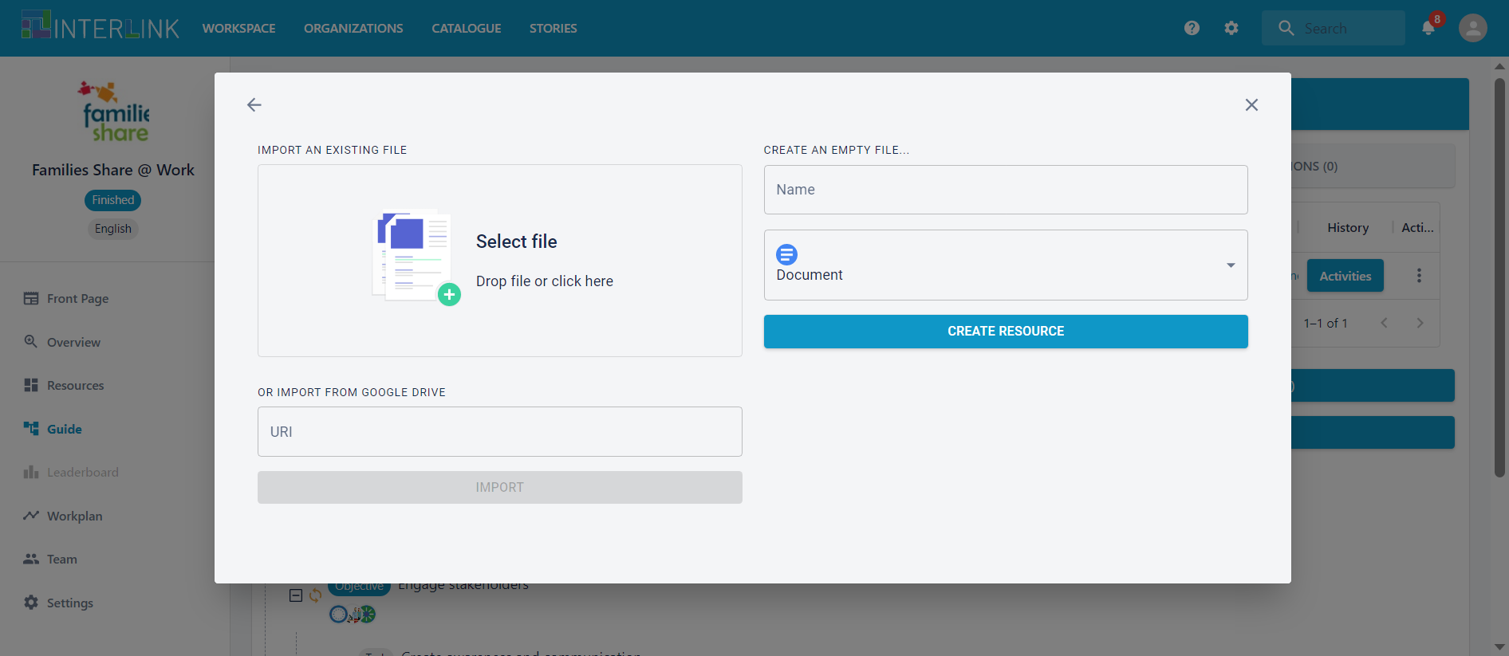
Import an existing document
You can also import an existing Google Drive compatible file by uploading it from your file system or by copying its Url.

Slide 39
Clone an existing resource

Slide 40
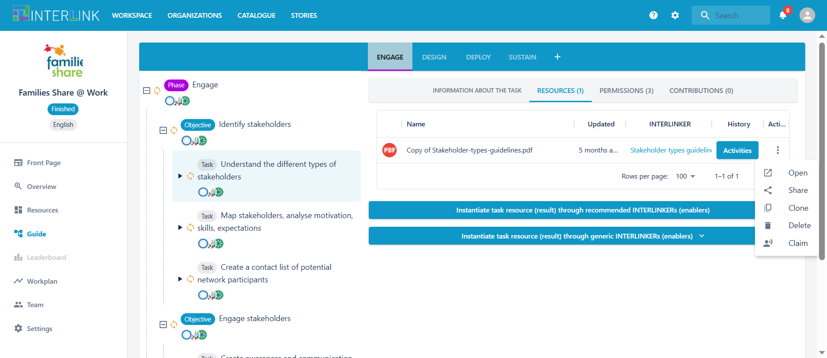
Clone a resource
You can clone a resource by opening the three dots menu on the right hand side and select the «clone» option.
This will create a copy of the original document that can be further customized.

Slide 41
Create a new resource starting from an existing template/INTERLINKER

Slide 42
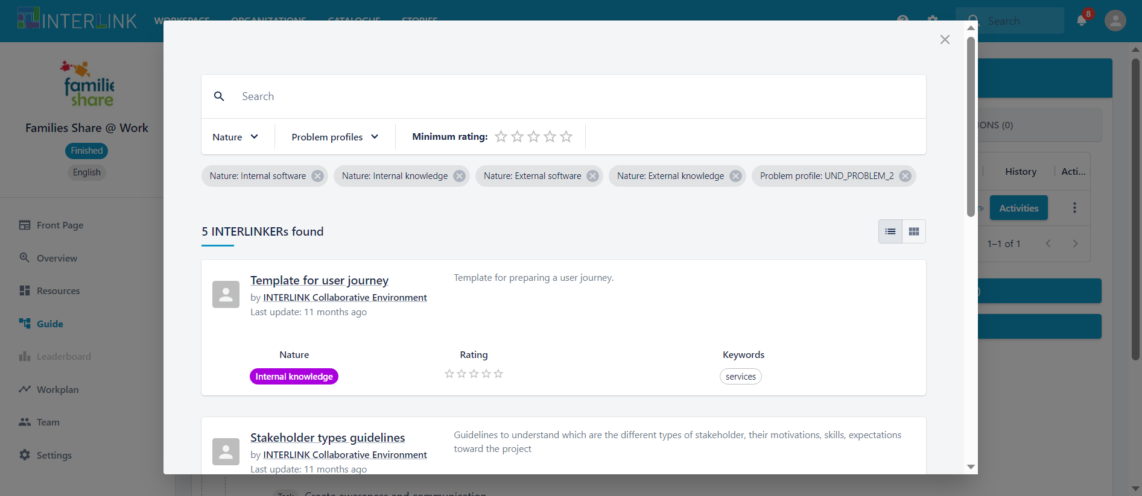
Reuse of an existing template
Within the resources section of a task, by clicking on the first blue button, you will be presented with a list of recommended resources that can be copied.

Slide 43
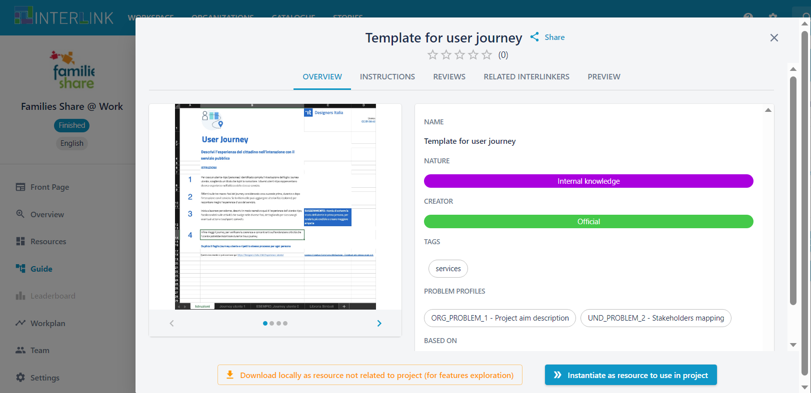
Download or instantiate INTERLINKERs
If you select one recommented INTERLINKER (by clicking on its name) a pop-up opens with further details and previews for the resource.
The two buttons at the bottom of the pop-up allow you to download or to make a copy of the resource to add it to your workspace.

Slide 44
How to share the link to a resource

Slide 45
Sharing the link to a resource
You can share the link to a resource by opening the three dots menu on the right hand side and selecting the «share» option.

Slide 46
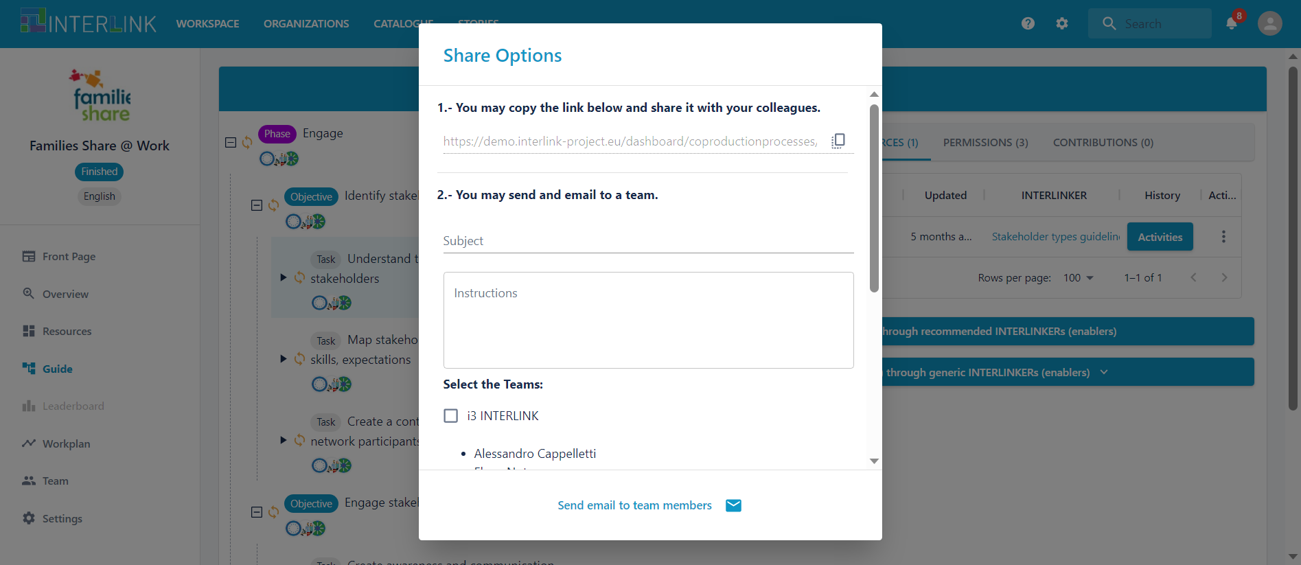
Getting the link and notifying people
You can copy the link that directly points to a resource to use it in your communications.
You can also send an email notification to teams of people with the link to the resource and a call for action.
Only users registered to the platform and with proper access rights will be able to access the resource.

Slide 47
You are now ready to participate to the co-production of services !
FOR MORE INFORMATION, CHECK OUT
THE USER MANUAL OF THE INTERLINK PLATFORM

Slide 48
This document, prepared by the INTERLINK European project, is licensed under a Creative Commons Attribution-ShareAlike 4.0 International licence (CC BY-SA 4.0).

